Slide 1
Graphs

Slide 2
A graph is a data structure that consists of a set of nodes (vertices) and a set of edges that connect pairs of nodes.
Nodes (Vertices): Nodes are the fundamental building blocks of a graph.
Each node represents an entity, and it may contain additional information.
For example, in a social network graph, nodes might represent users, while in a transportation network graph, nodes might represent locations or cities.

Slide 3
Edges: Edges are the connections between nodes.
They represent relationships or interactions between the entities represented by the nodes.
An edge may be directed or undirected.
In a directed graph, edges have a specific direction indicating a one-way relationship, while in an undirected graph, edges have no inherent direction.

Slide 4
Weighted Graphs:
In addition to edges connecting nodes, a weighted graph assigns a weight or cost to each edge.
These weights represent some measure of distance, cost, or importance associated with traversing the edge.
Weighted graphs are used to model scenarios where edges have varying degrees of significance.

Slide 5
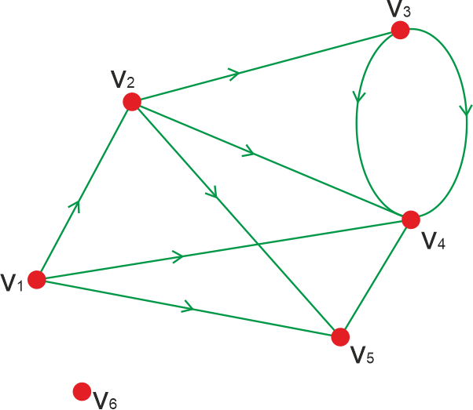
Degree:
The degree of a node is the number of edges incident to that node. In a directed graph, nodes have both an in-degree (number of incoming edges) and an out-degree (number of outgoing edges)

Slide 6
Path: A path in a graph is a sequence of nodes connected by edges.
It represents a route through the graph from one node to another.
The length of a path is the number of edges it contains.
Cycle: A cycle in a graph is a path that starts and ends at the same node, traversing a sequence of distinct nodes and edges along the way.

Slide 7
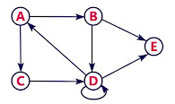
Representation of Graphs
Adjacency Matrix:
This is a 2D array where each cell A[i][j] represents the connection between vertex i and vertex j.
For an undirected graph, it is symmetric; for a directed graph, it may not be.
The value in each cell can represent the weight of the edge or simply whether there's an edge (e.g., 1 for presence, 0 for absence).

Slide 8
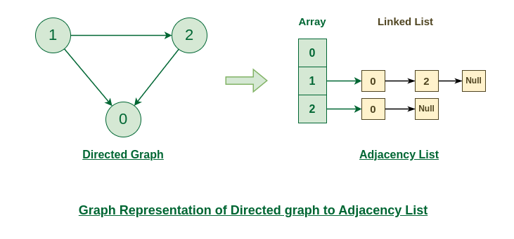
Adjacency List:
This is a collection of lists or arrays where each list/array represents a vertex and contains the vertices that are adjacent to it.
This representation is more memory-efficient for sparse graphs.

Slide 9
Spanning tree
A spanning tree is a subset of Graph G, such that all the vertices are connected using minimum possible number of edges.
Hence, a spanning tree does not have cycles and a graph may have more than one spanning tree.

Slide 10
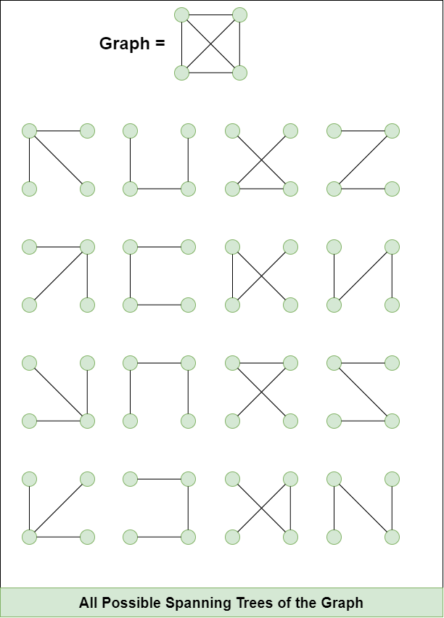

Slide 11
Properties of a Spanning Tree:
A Spanning tree does not exist for a disconnected graph.
For a connected graph having N vertices then the number of edges in the spanning tree for that graph will be N-1.
A Spanning tree does not have any cycle.
We can construct a spanning tree for a complete graph by removing E-N+1 edges, where E is the number of Edges and N is the number of vertices.

Slide 12
Minimum Spanning Tree
The minimum spanning tree has all the properties of a spanning tree with an added constraint of having the minimum possible weights among all possible spanning trees.
Like a spanning tree, there can also be many possible MSTs for a graph.

Slide 13
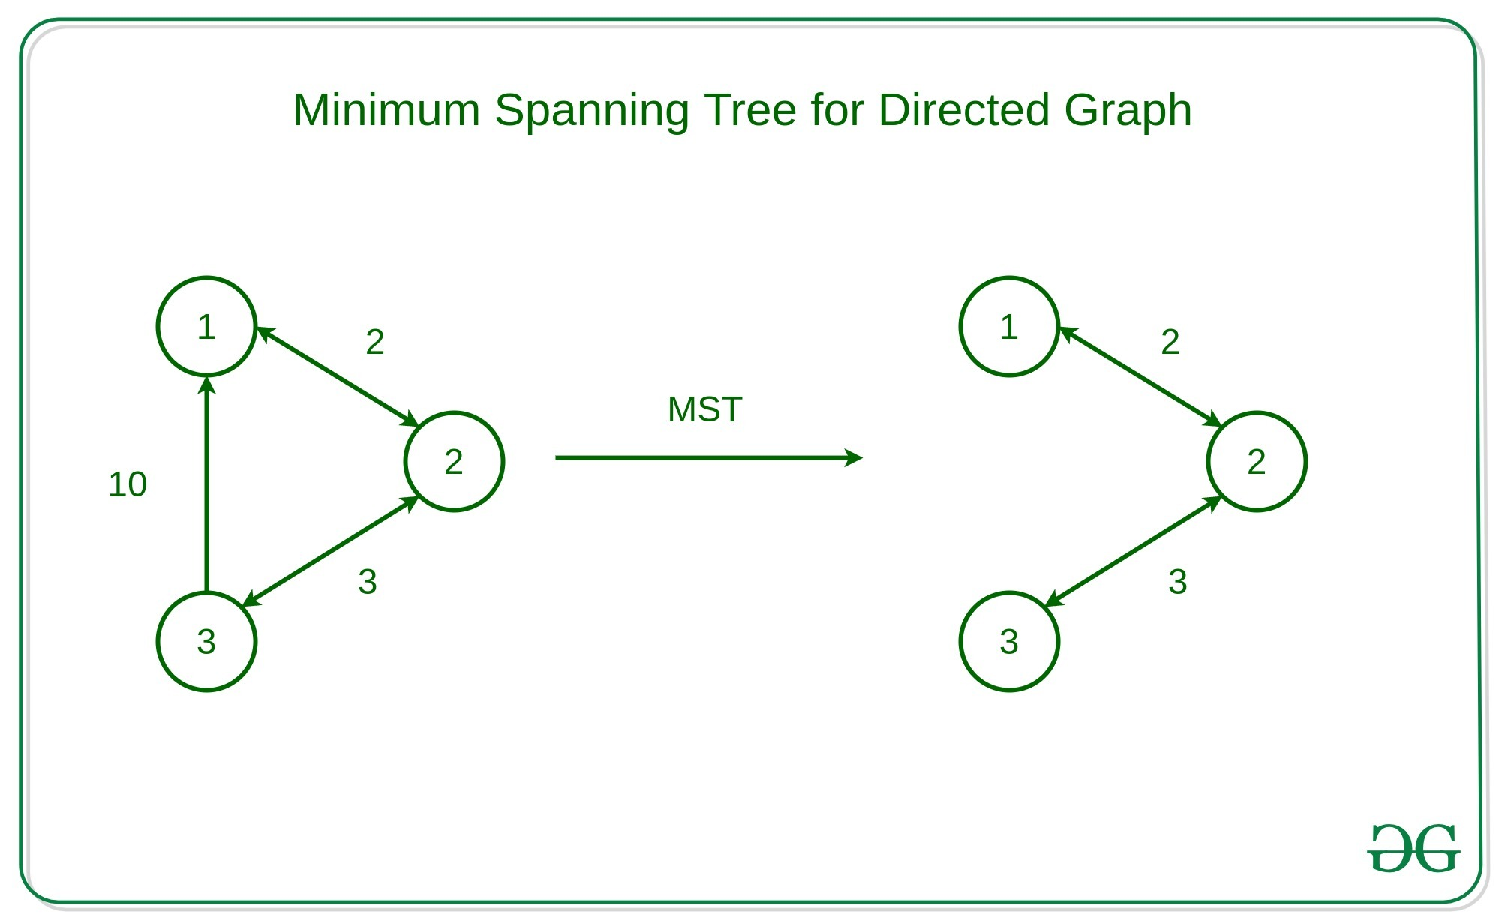

Slide 14
Kruskal’s Algorithm
Kruskal's algorithm is a greedy algorithm used to find the minimum spanning tree (MST) of a connected, weighted graph.
The algorithm builds the MST by adding edges to the tree in ascending order of their weights until all vertices are included in the tree.
Steps:
Sort Edges: Sort all the edges of the graph in non-decreasing order of their weights.
Initialize: Create an empty set to store the edges of the MST.
Iterate Over Edges: Iterate through the sorted edges and add each edge to the MST if adding it does not create a cycle.
Check for Cycle: Before adding an edge, check if adding it would create a cycle in the MST. This can be done using disjoint-set data structure or Union-Find algorithm.

Slide 15
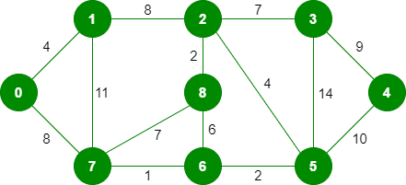

Slide 16
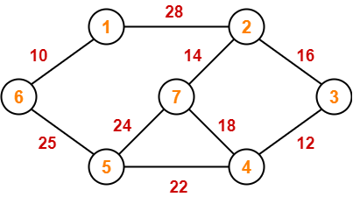

Slide 17
Prim’s Algorithm
Prim’s algorithm is also a Greedy algorithm.
This algorithm always starts with a single node and moves through several adjacent nodes, in order to explore all of the connected edges along the way.
Step 1: Start with a vertex (let's call it the starting vertex) and mark it as visited.
Step 2: Find all edges connected to the current vertex that lead to unvisited vertices. Choose the edge with the lowest weight.
Step 3: Add the chosen edge to the minimum spanning tree and mark the corresponding vertex as visited.
Step 4: Repeat steps 2 and 3 until all vertices are visited.

Slide 18
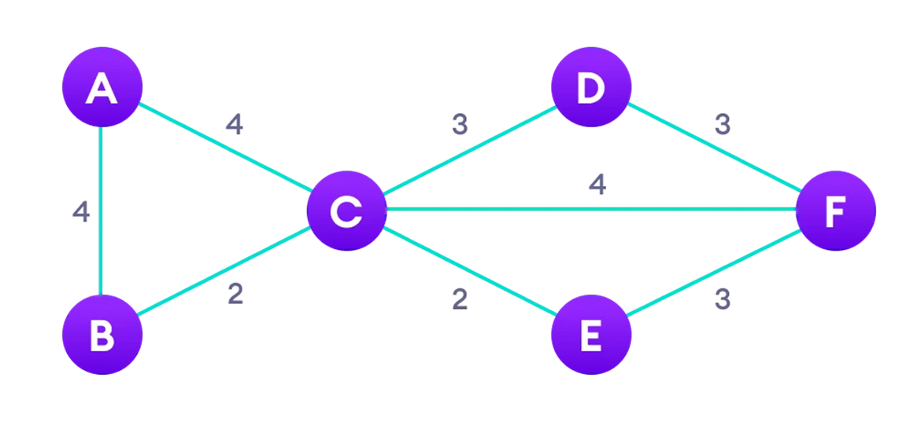

Slide 19
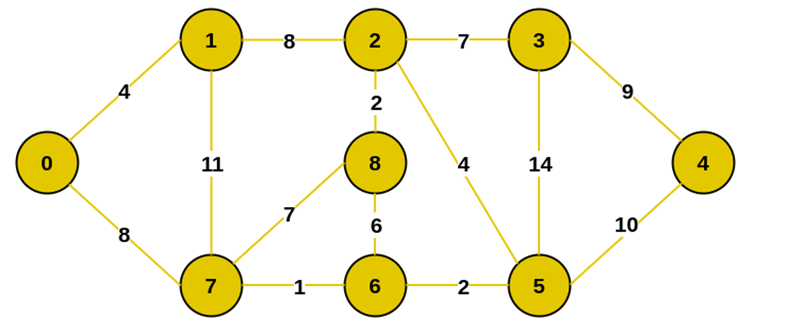

Slide 20
Time Complexity:
O(V²), If the input graph is represented using an adjacency list.
the time complexity of Prim’s algorithm can be reduced to O(E * logV) with the help of a heap.

Slide 21
Breadth First Search
Breadth First Search (BFS) is a graph traversal algorithm that explores all the vertices in a graph at the current depth before moving on to the vertices at the next depth level.
It starts at a specified vertex and visits all its neighbors before moving on to the next level of neighbors.
BFS is commonly used in algorithms for pathfinding, connected components, and shortest path problems in graphs.

Slide 22
Breadth First Search (BFS) for a Graph Algorithm:
Let’s discuss the algorithm for the BFS:
Initialization: Enqueue the starting node into a queue and mark it as visited.
Exploration: While the queue is not empty:
Dequeue a node from the queue and visit it (e.g., print its value).
For each unvisited neighbor of the dequeued node:
Enqueue the neighbor into the queue.
Mark the neighbor as visited.
Termination: Repeat step 2 until the queue is empty.

Slide 23
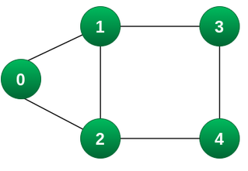

Slide 25
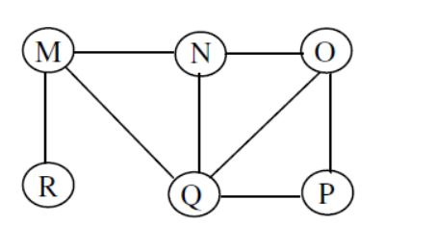

Slide 26
Time Complexity of BFS Algorithm: O(V + E)
BFS explores all the vertices and edges in the graph.
In the worst case, it visits every vertex and edge once.
Therefore, the time complexity of BFS is O(V + E), where V and E are the number of vertices and edges in the given graph.

Slide 27
Applications of BFS in Graphs
BFS has various applications in graph theory and computer science, including:
Shortest Path Finding: BFS can be used to find the shortest path between two nodes in an unweighted graph. By keeping track of the parent of each node during the traversal, the shortest path can be reconstructed.
Cycle Detection: BFS can be used to detect cycles in a graph. If a node is visited twice during the traversal, it indicates the presence of a cycle.
Connected Components: BFS can be used to identify connected components in a graph. Each connected component is a set of nodes that can be reached from each other.
Topological Sorting: BFS can be used to perform topological sorting on a directed acyclic graph (DAG). Topological sorting arranges the nodes in a linear order such that for any edge (u, v), u appears before v in the order.
Level Order Traversal of Binary Trees: BFS can be used to perform a level order traversal of a binary tree. This traversal visits all nodes at the same level before moving to the next level.
Network Routing: BFS can be used to find the shortest path between two nodes in a network, making it useful for routing data packets in network protocols.

Slide 28
Depth First Search or DFS for a Graph
Depth-first search is an algorithm for traversing or searching tree or graph data structures.
The algorithm starts at the root node (selecting some arbitrary node as the root node in the case of a graph) and explores as far as possible along each branch before backtracking.

Slide 29
Here's how DFS works for a graph:
1. Choose a starting vertex.
2. Mark it as visited.
3. Explore one of its neighbors that hasn't been visited.
4. Repeat step 3 until there are no unvisited neighbors.
5. Backtrack to the previous vertex and explore another unvisited neighbor.
6. Repeat steps 3-5 until all vertices are visited.

Slide 30
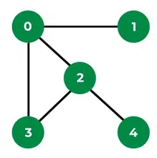

Slide 32
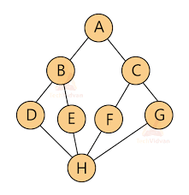

Slide 33
Time complexity: O(V + E), where V is the number of vertices and E is the number of edges in the graph.
Applications of Depth First Search
Detecting cycle in a graph
Path Finding
Web crawlers

Slide 34
Topological Sorting
Topological sorting is a fundamental algorithm used in graph theory, particularly with directed acyclic graphs (DAGs).
It arranges the vertices of a graph in such an order that for every directed edge from vertex u to vertex v, u comes before v in the ordering.
Topological Sorting for a graph is not possible if the graph is not a DAG.

Slide 35
This is due to the fact that undirected edge between two vertices u and v means, there is an edge from u to v as well as from v to u.
Because of this both the nodes u and v depend upon each other and none of them can appear before the other in the topological ordering without creating a contradiction.

Slide 36
Initialize: Create a list to store the sorted nodes and a set to store nodes that have been visited.
DFS traversal: Perform a Depth-First Search (DFS) traversal of the graph starting from any unvisited node.
During the traversal, mark each visited node.
Recursion: During the DFS traversal, when you visit a node, recursively visit all its adjacent nodes that have not been visited yet.
Backtracking: When you finish visiting all adjacent nodes of a node, add that node to the sorted list.
Finalize: Once you have visited all nodes in the graph, the sorted list will contain the topologically sorted order of the nodes.

Slide 37
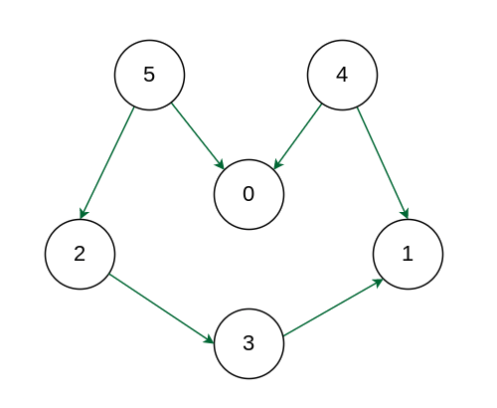

Slide 38
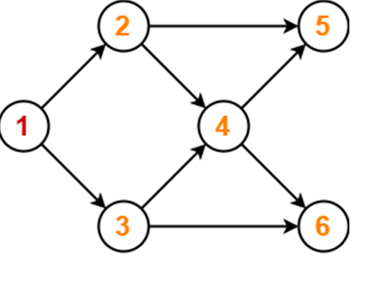

Slide 39
Binary Heap
A binary heap is a complete binary tree where each node has a value greater than or equal to (for a max-heap) or less than or equal to (for a min-heap) the values of its children.

